Slide 1


CASTNXT
Shubham Parashar
Mounika Balivada
Anushka Garg
Rohan Gupta Kandikonda
Siddharth Devulapalli

Slide 2
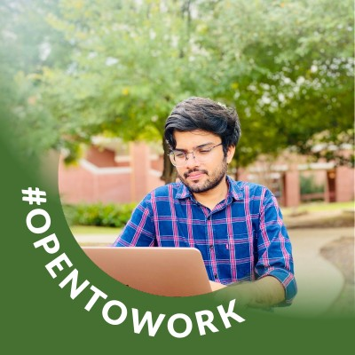


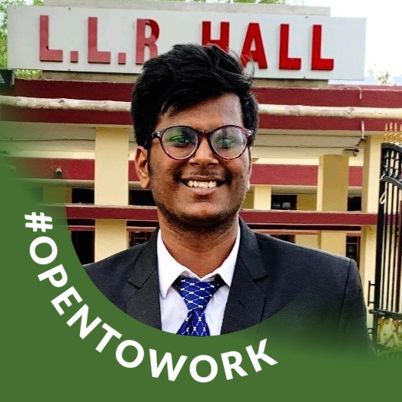

Team - Codevils

Slide 3


the What and WHY?
Our client FashioNxt operates in the fashion industry
Main idea: Simplify and Automate talent registration, assignment and management for events.
FashioNxt is responsible for conducting events, user management, orchestration etc.

Slide 4



WHO will use our app?
FashioNXT – Admins/Producers: Manage the App.
Event Participants / Models – Talents: Search and Register for Events.
Designers / Presenters – Clients: Showcase events using assigned Talents.

Slide 5
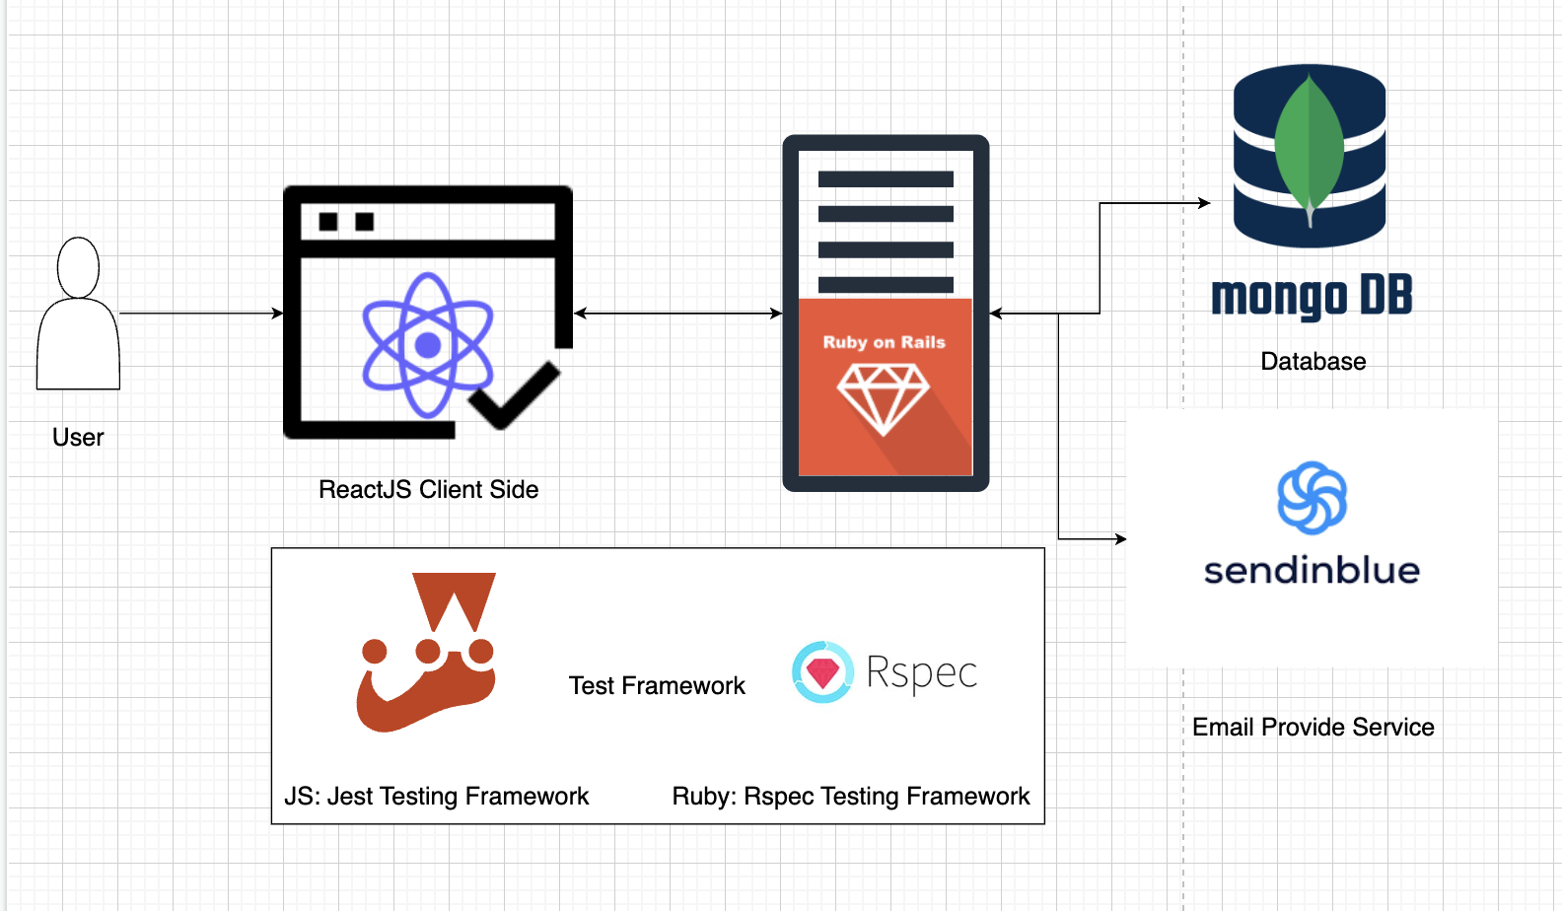
App Design Overview
This a legacy project with ReactJS, Ruby and MongoDB.
For quality we have added JEST for ReactJS testing.
For emails, we have integrated with SendInBlue APIs. Easy and reliable.
Main Idea was to have a thin client and micro-service driven backend

Slide 6
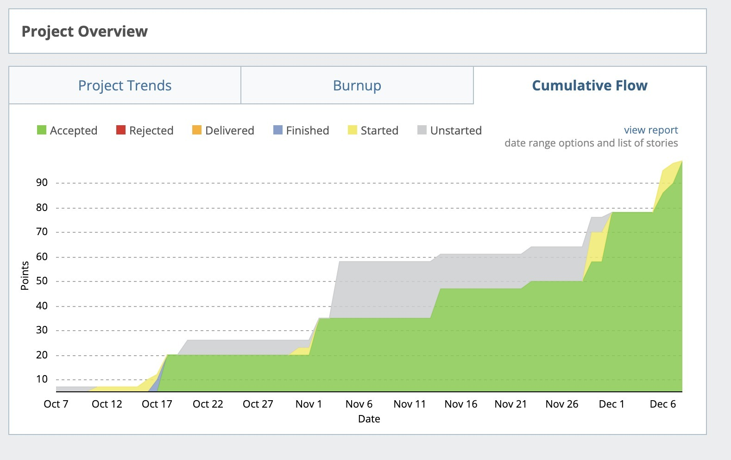
User Story Burn-Down
Equal focus on backend, UI and quality.
As requirements became clearer, code velocity increased.
Close to 100 points of user-stories delivered.

Slide 7
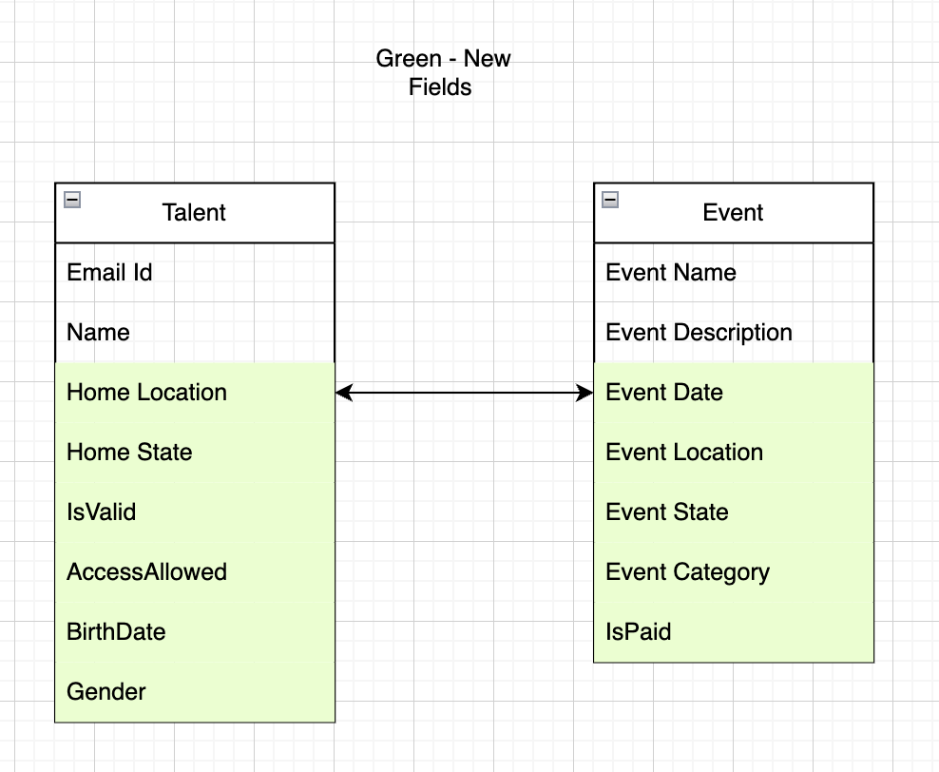
Key Backend Features
Signup Validation and proper authentication.
Auto Fill functionality for user forms.
Meta-data addition to different tables.
Cross app integration for CRM team.
Email notifications features.

Slide 8
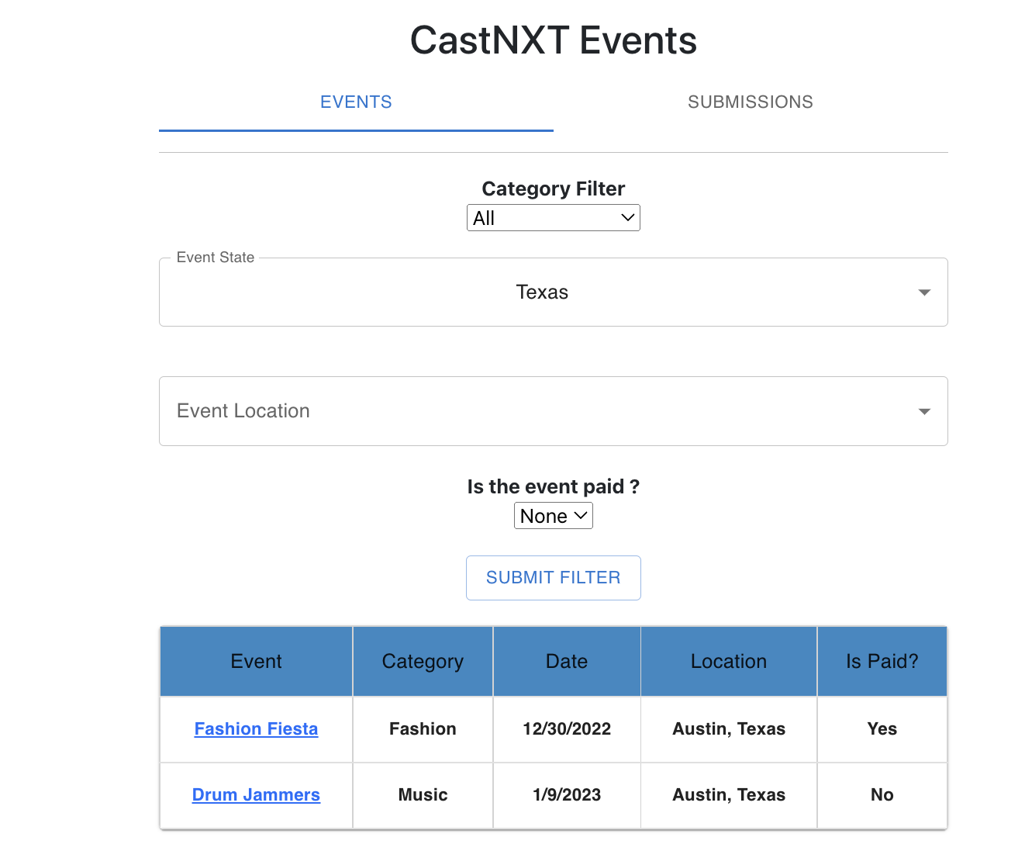
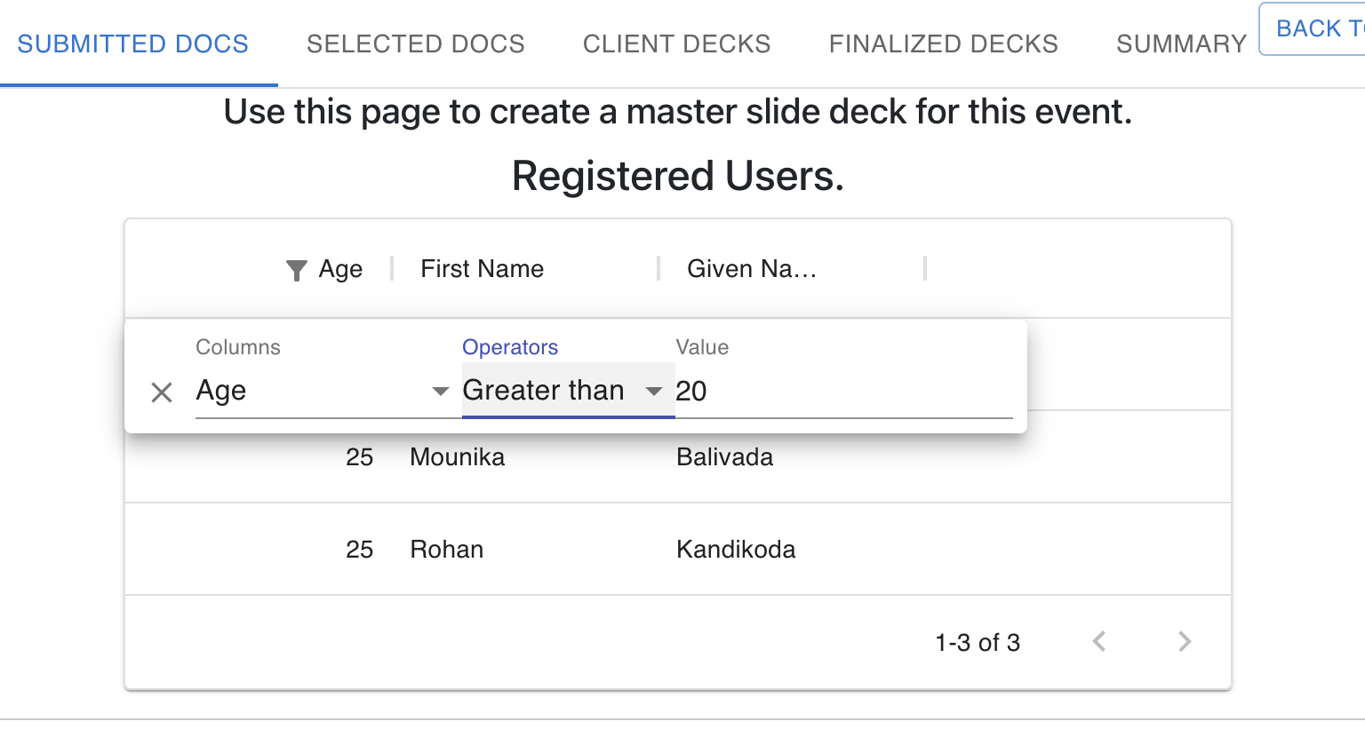
Key UI enhancements
Implemented filtering for user ease and search.
Fixed legacy bugs and improved the experience overall
Cancelled Event Notification and Email for registered talents

Slide 9
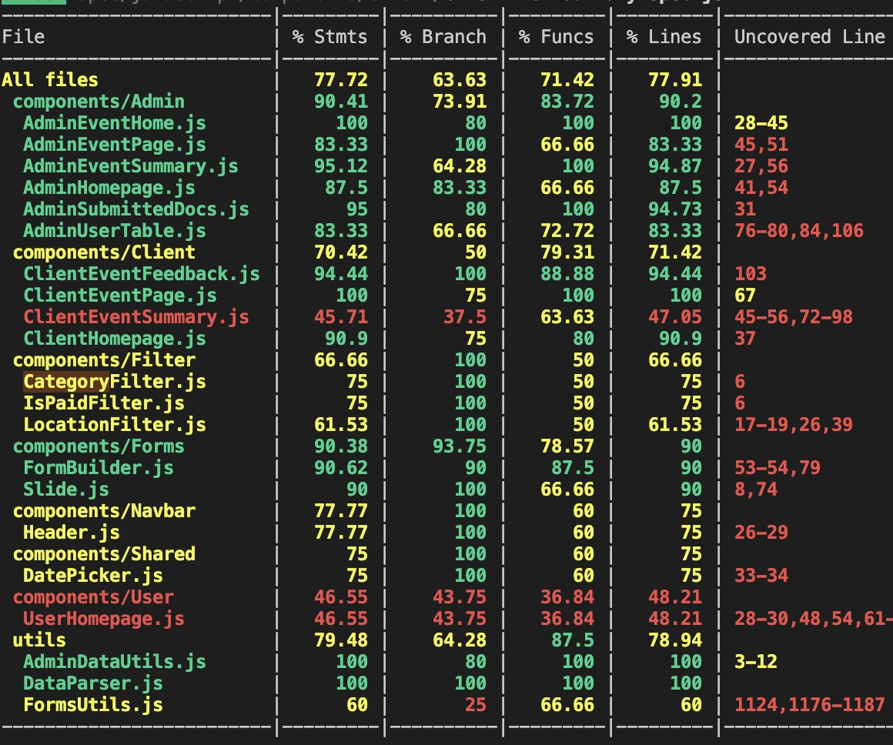
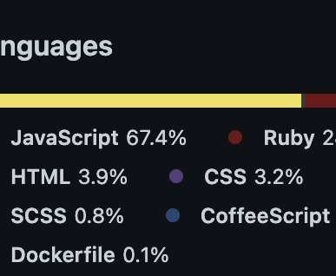
Quality matters
Previous team used ReactJS, but no testing framework was present.
Added JEST, a JS testing framework have approximate 80% coverage.
Added more Ruby tests based on functionality.
Refactored code using code-climate feedback

Slide 10
Way Forward – Future Product Requirements
Event filtering on Client side event table.
Edit existing live forms for an event.
General Notification spotlight
Color coding on slide table.
Mobile friendly experience for CASTNXT app.
Custom email from producer to talent.

Slide 11
WAY FORWARD - TECH DEBT
Database restructuring for future feature development.
Ruby version 2.6.6 to 3.1.2 migration.
Nodemon integration.
Legacy form preview component update.

Slide 12
Learnings
Our product manager and scrum master changed each iteration, giving exposure to the specifics of each role.
Requirements evolved and changed over time, highlighting the continuous nature of software development.
Thanks to our client, we understood a business problem end to end.
As students, time management and scrum management is tricky.
Learnt prioritizing stories, and workload management.

Slide 13

Challenges
Legacy Code onboarding is always a challenge.
Heroku Deployment with Ruby2.6 can be tricky.
Knowledge transfer with previous team, is important for quick ramp-up.
Cloud Editors can be slow, and inconsistent at times.

Slide 14

DEMO
App: https://castnxt-final.herokuapp.com/
Demo: https://youtu.be/PVcpLw3_sP4

